Slide 1
Auto marking Program
Mir-Lab, Hanyang University
Version | Date | Writer | Modification | Note
1.0 | 2018-01-08 | HYUNJIN PARK | Draft | -
1.1 | 2018-03-06 | HYUNJIN PARK | Restful API | -
1.2 | 2018-03-17 | LI YANG | Flowchart Code Explanation
1.3 | 2018-03-23 | LI YANG | How to execute (Screenshot)
1.4 | 2018-04-02 | LI YANG & HYUNJIN PARK | Add background information and answer feedback

Slide 2
Outline
Background
Explanation (Purpose, Development Environment, Testing Factors)
System Architecture
Flowchart
Code Explanation
How to execute (Screenshot)
Future Work

Slide 3
BG:기존 채점 서버의 구조 & 역할 설명
Web client Auto marking system
Testing Factors
GET, POST Method
Client Receive Buffer
If tester’s client can receive over 1024Bytes Message or not
Picture
Give random number of pictures and check how many receive
(Optional) What picture did tester receive
Text
What tester receive ? Choose among several numbers
Protocol Version(Future Work)
Should use HTTP version 1.1
Header
If tester can change User-Agent in header
Database
MySQL
166.104.143.225:3306
Data Store
Data Query
Shared Memory
채점 내용 저장
채점 내용 저장
Main
HTTP Server
Create Socket
Sub
HTTP Server
166.104.143.225:9998/index.html
166.104.143.225:(Random)/test/index

Slide 4
BG:기존 채점 서버의 구조 & 역할 설명
Web client Auto marking system---Initial(Create socket for students’ client )
Main Thread
Management Thread
DB
시작
Create Management Thread
3 minute
Create Server Socket for main page
Get Expired Data from DB
Delete Expired Files
Sleep few second
A

Slide 5
BG:기존 채점 서버의 구조 & 역할 설명
Web client Auto marking system---create sub thread for
each students for test.
Client #1
Client #2
(for test)
Main Thread
Sub Thread #1
Sub Thread #2
DB
A
Connect to main page
Create Sub thread
for processing request
Send main page
Exit thread
Send User Data
Create Sub thread
for processing request
Create Random Files
Save Data to DB (random files, user data, ...)
Create Sub thread
for client test
Send announce page
Include test page URL
C
D
E
Exit thread
F
Notes:
Get Expired Data from DB (example query)
select html_file, image_file1, image_file2, image_file3 from client_test where timestamp < DATE_ADD(now(), INTERVAL -3 minute)
Create Random Files
테스트용 이미지 파일 중 몇 개를 선정하여 각 파일을 무작위 이름의 파일로 복사한다.
추가로, 랜덤으로 생성된 이미지 파일의 경로를 포함하는 html 파일을 생성하여 저장한다.

Slide 6
BG:기존 채점 서버의 구조 & 역할 설명
Web client Auto marking system—Check each mission(ex: GET different file )
Client #2
(for test)
Sub Thread #2
DB
D
F
Connect to test page
Get html file
Check http header
Save result of header checking
Send html file
Connect to test page
Get image file #n
Check http header
Save result of header checking
Send image file

Slide 7
BG:기존 채점 서버의 구조 & 역할 설명
Web client Auto marking system—Marking for test
Client #1
Main Thread
Sub Thread #1
DB
C
E
Connect to answer page
Create Sub thread
for processing request
Get Data from DB
Send answer page
Send answer
Exit thread
Create Sub thread
for processing request
Get Data from DB
Write Result Data to DB
Send result page
Exit thread

Slide 8
BG:기존 채점 서버의 구조 & 역할 설명
Web server Auto marking system
Testing Factors
(1) Socket & Program Handling
Weather the Web Server Socket is open
MultiThread
– If server is running single thread , error will happen if it gets one same message several times.
(2) Send content correctly if Get Method comes.
(3) ERROR Handling
-Different response (200OK/404NOT FOUND/400 BAD REQUEST based on different request
(4) HTTP Header Handling Check
-Content Length – Data size should be changeable
-Content Type – Both txt and image can be handled
Database
(mysql 166.104.143.225:3306)
One Program
HTTP
SERVER
Test Result
HTTP
Client
Shared Memory

Slide 9

BG:기존 채점 서버의 구조 & 역할 설명
Web server Auto marking system
Students
HTTP Server
HTTP Client
Mysql Database
Visit Website
166.104.143.225/index.html
GET Method
Response
Index.html
HTTP/1.1 200 OK
Input Student Information
166.104.143.225/index.html
POST Method
Start HTTP Client Thread
to check Student Server
based on Student Info
Result Page
that if How Student Server
Woks(error or correct)
Check Processing
Response
Result(Show Result Page)
HTTP/1.1 200 OK
Execute query Student
Test Result to save
9

Slide 10
1) What is RESTful API?
Conforms to the representational state transfer or REST model.
Easier for developers to use because they have a familiar syntax and set of protocols.
As more functionality has been built into the internet, developers have talked a lot about the benefits of RESTful architecture.
Method | Meaning | Idempotent
GET | Read | No
PUT | Create | Yes
POST | Update | Yes
DELETE | Delete | Yes
*Idempotent: 여러 번 수행해도 결과가 같은 지 여부

Slide 11
What is RESTful API?
RESTful is classified as Resource, Method, Message (3 Factors)
Example) “User Hyunjin creates new user”
“New User”is Resource that will be created
“Create” is Method
“User Hyunjin” is Message
Practice)
HTTP POST , http://myweb/users/
{
"users":{
"name":“Hyunjin"
}
}
Method
Resource
Message

Slide 12
1) RESTful API Status(General)
Method | Code | Status | Explanation
General | 400 | BAD REQUEST | The request was invalid or cannot be otherwise served. An accompanying error message will explain further. For security reasons, requests without authentication are considered invalid and will yield this response
 | 401 | UNAUTHORIZED | The authentication credentials are missing, or if supplied are not valid or not sufficient to access the resource
 | 403 | FORBIDDEN | The request has been refused. See the accompanying message for the specific reason (most likely for exceeding rate limit)
 | 404 | NOT FOUND | The URI requested is invalid or the resource requested does not exists.
 | 406 | NOT ACCEPTABLE | The request specified an invalid format
 | 410 | GONE | This resource is gone. Used to indicate that an API endpoint has been turned off
 | 429 | TOO MANY REQUEST | Returned when a request cannot be served due to the application’s rate limit having been exhausted for the resource
 | 500 | INTERNAL SERVER ERROR | Something is horribly wrong
 | 502 | BAD GATEWAY | The service is down or being upgrade
 | 503 | SERVICE UNAVAILABLE | The service is up, but overloaded with requests. Try again later.
 | 504 | GATEWAY TIME OUT | Servers are up, but the request couldn’t be serviced due to some failure within our stack. Try again later

Slide 13
1) RESTful API Status(GET, POST, PUT, DELETE)
Method | Code | Status | Explanation
GET | 200 | OK | The request was successful and the response body contains the representation requested.
 | 302 | FOUND | A common redirect response; you can GET the representation at the URI in the Location response header.
 | 304 | NOT MODIFIED | There is no new data to return.
POST & PUT | 201 | OK | The request was successful, we updated the resource and the response body contains the representation.
 | 202 | ACCEPTED | The request has been accepted for further processing, which will be completed sometime later.
DELETE | 202 | ACCEPTED | The request has been accepted for further processing, which will be completed sometime later.
 | 204 | OK | The request was successful; the resource was deleted.

Slide 14
2) Purpose
As the artificial intelligence society develops, the development of automatic scoring program for program codes is spreading in various countries and various companies.
The goal of the program is to analyze and evaluate the input program in terms of various test case and process, to recognize the error in the process through Code Review, and to improve the ability to solve problems and performance.
You can use these core RESTful API to develop your off – platform application.
By sending request URL you can get the information or post necessary configuration you want

Slide 15
2) Restful API Testing Factors
Test를 위한 Device, Host, Link 등에 대한 정보는 채점 서버에서 제공(JSON)
GET – Get Switch, Link, Host Information and Fill in the blanks
POST – Create Switch, Host, Link
DELETE – Delete Switch, Host, Link that students create

Slide 16
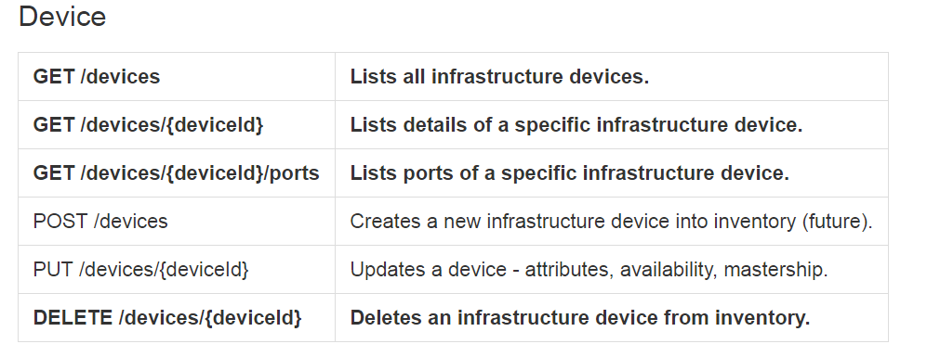
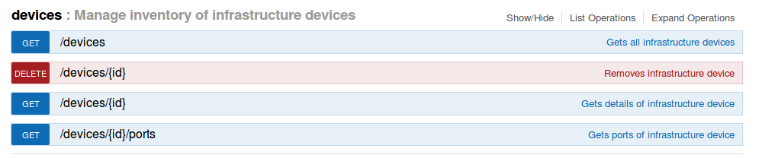

2) Restful API Testing Factors
POST – Create Switch, Host, Link
This Restful auto marking program is based on the URL in ONOS server, also uses the methods defined in ONOS . In ONOS, they want to use post as a created method, and put to update. However, post or put a node/link function is not implemented now. Flow provisioning uses post to create flow.
So, this auto marking system is trying to make a ONOS-like environment for students to have a better and faster understand about the restful northbound interface of ONOS, which is the most basic concept to implement a simple and easy to use northbound application.

Slide 17
2) Summary: Core RESTful APIs
 | GET | DELETE | POST
Device | GET /devices | DELETE /devices/{deviceId} | POST /devices
 | GET /devices/{deviceId}
Link | GET /links |  | POST /links
 | GET /links/{device=deviceId}
Host | GET /hosts |  | POST /hosts
 | GET /hosts/{hostId}
Flow | GET /flows/{deviceId} | DELETE /flows/{deviceId}/{flowId} | POST /flows/{deviceId}
 | GET /flows
Notes:
ONOS REST API Overview-

Slide 18
2) Restful API Testing Factors
Test를 위한 Device, Host, Link 등에 대한 정보는 채점 서버에서 제공(JSON)
GET – Get Device ID, Ports, Link, Host Information and Fill in the blanks
POST – Create Device, Link
DELETE – Delete Device, Link that students create

Slide 19
3) System Architecture
Database
(mysql 166.104.143.225:3306)
Java Framework
Core
Core
Student
Manage
HTTP
SERVER
Request
HTTP
Client
Test Result
Response
Shared Memory
File
Input Stream
Device, Link
, Host and etc.
(JSON)

Slide 20
4.1) Server Flow Chat-GET
HTTP
SERVER
HTTP
Client
Core
Core
Student
Successful GET Request
HTTP
SERVER
Request
HTTP
Client
Response
200 OK Response
(JSON)
File
Input Stream
Bad URL Request
Device, Link
, Host and etc.
(JSON)
Error Response
(400 Bad Request)
Unknown File Request
Error Response
(404 Not Found)

Slide 21
4.1) Server Flow Chat-GET
GET-Switch
Switch JSON Format
{
"number": "2",
"opts": {
"controllers": [
"c0"
],
"hostname": "s2",
"nodeNum": 2,
"switchType": "default"
},
"x": "549.0",
"y": "276.0"
}
1. Get all switches
URL: http://<IP>:<PORT>/onos/v1/devices
2. Get one of the switches (ex: switches 3)
URL: http://<IP>:<PORT>/onos/v1/devices/3

Slide 22
4.1) Server Flow Chat-GET
Get all switches
Get one of the switches (ex: switches 3)

Slide 23
4.1) Server Flow Chat-GET
GET-Hosts
Host JSON Format
{
"number": "2",
"opts": {
"hostname": "h2",
"nodeNum": 2,
"sched": "host"
},
"x": "606.0",
"y": "506.0"
},
1. Get all hosts
URL: http://<IP>:<PORT>/onos/v1/hosts
2. Get one of the hosts (ex: host 3)
URL: http://<IP>:<PORT>/onos/v1/hosts/3

Slide 24
4.1) Server Flow Chat-GET
Get all hosts
Get one of the hosts (ex: hosts 3)

Slide 25
4.1) Server Flow Chat-GET
GET-Links
Link JSON Format
{
"dest": "s2",
"opts": {},
"src": "s3"
},
{
"dest": "s1",
"opts": {},
"src": "s2"
}
1. Get all links
URL: http://<IP>:<PORT>/onos/v1/links
2. Get one device’s link (ex: device 1)
URL: http://<IP>:<PORT>/onos/v1/links/s1

Slide 26
4.1) Server Flow Chat-GET
Get all links
Get one device’s link (ex: device 1)

Slide 27
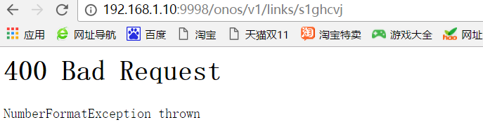
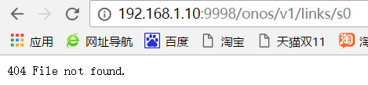
4.1) Server Flow Chat-GET
Bad Request
404 Not Found

Slide 28
4.2) Server Flow Chat-POST
HTTP
SERVER
HTTP
Client
Core
Core
Student
Successful POST Request
HTTP
SERVER
Request
HTTP
Client
Response
File
Input Stream
201 Created Response
Device, Link
, Host and etc.
(JSON)
Bad POST Request
Error Response
(400 Bad Request)
HYU 2015 TIPW
28

Slide 29
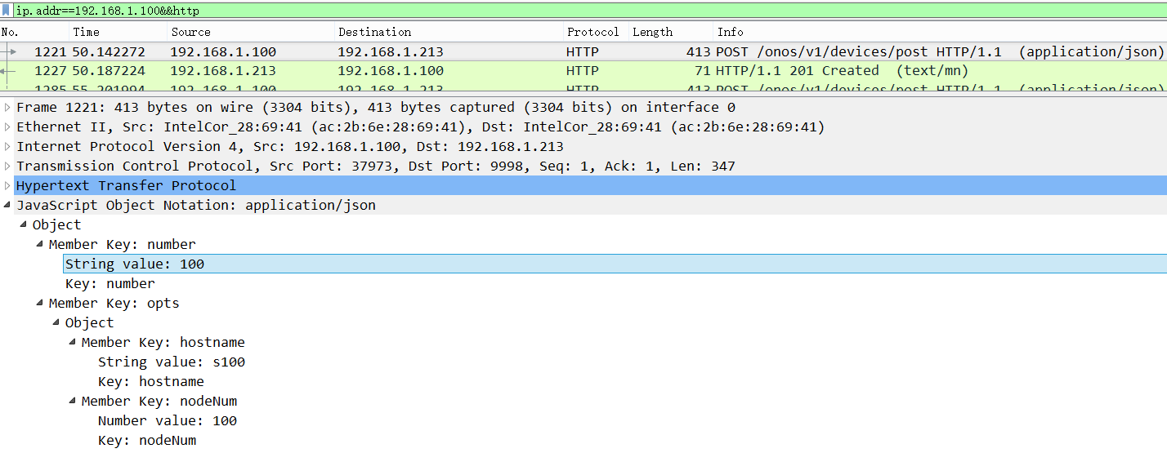
4.2) Server Flow Chat-POST
Post one Device(ex: device 100)
URL：http://192.168.1.10:9998/onos/v1/devices/post

Slide 30
4.3) Server Flow Chat-DELETE
HTTP
SERVER
HTTP
Client
Core
Core
Student
Successful Delete Request
HTTP
SERVER
Request
HTTP
Client
Response
File
Input Stream
200 OK Response
Device, Link
, Host and etc.
(JSON)
Bad POST Request
Error Response
(400 Bad Request)
30
HYU 2015 TIPW
30

Slide 31
4.3) Server Flow Chat-DELETE
Delete one Device(ex: device 2)
URL：http://192.168.1.10:9998/onos/v1/devices/delete
Delete one Host(ex: host 2)
URL：http://192.168.1.10:9998/onos/v1/hosts/delete

Slide 32
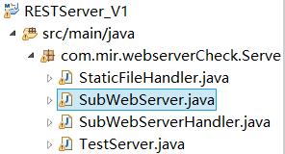
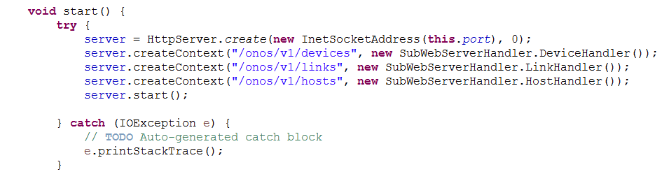
5) Code Explanation
Server Start
Parsing URL

Slide 33
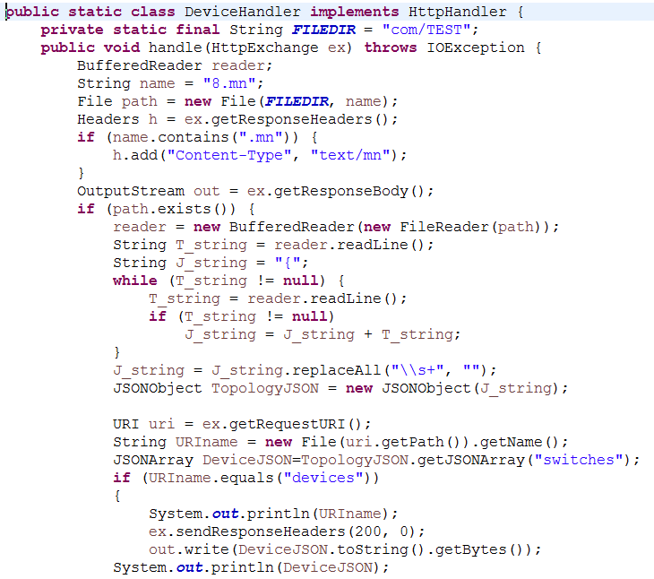
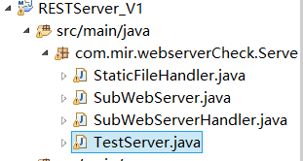
5.1.1) Code Explanation- GET Switch information
Device Handler
Access the file
Parsing JSON
Build 200 Response

Slide 34
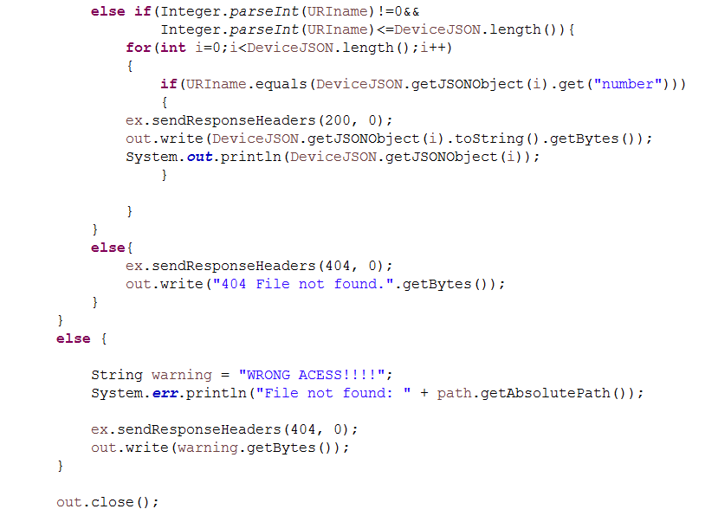
5.1.1) Code Explanation- GET Switch information
Device Handler
Find one switch
Build 404 Response

Slide 35
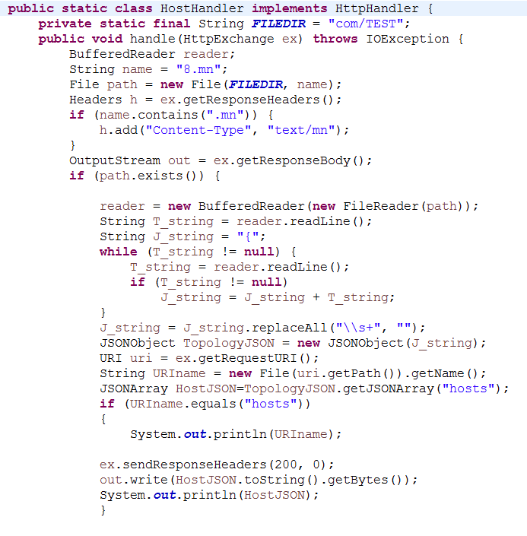
5.1.2) Code Explanation- GET Host information
Host Handler
Access the file
Parsing JSON
Build 200 Response

Slide 36
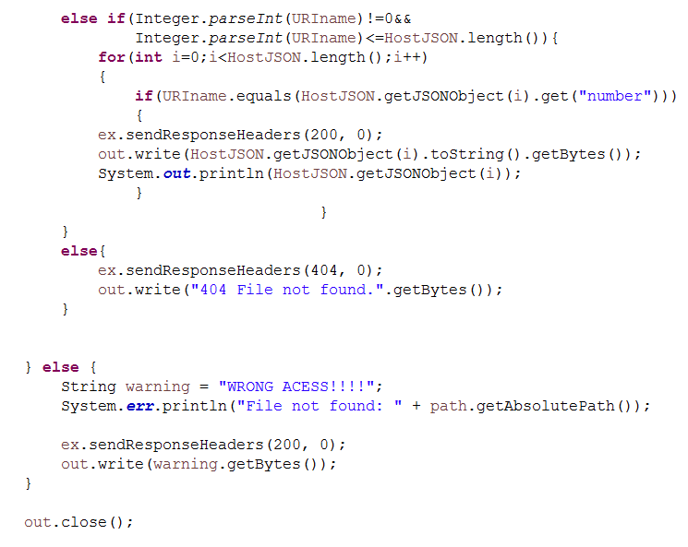
5.1.2) Code Explanation- GET Host information
Host Handler
Find one host
Build 404 Response

Slide 37
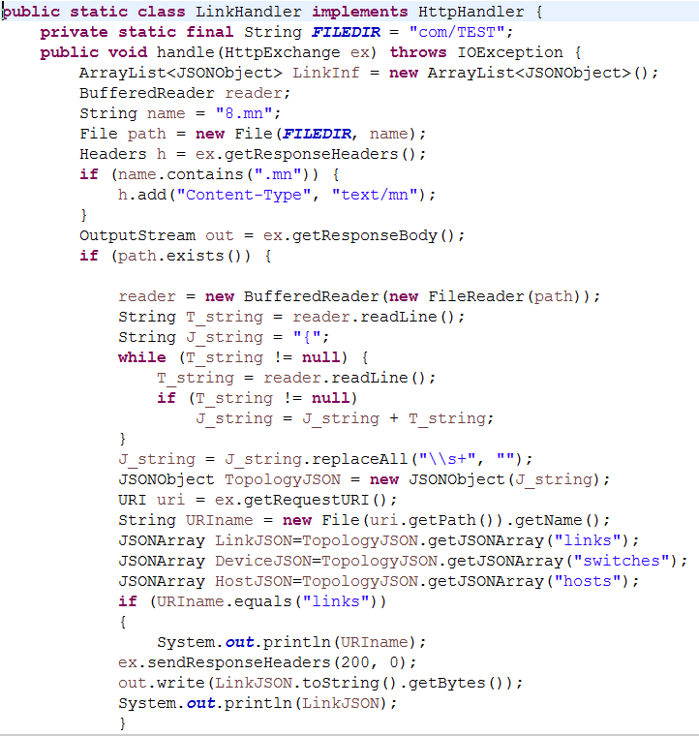
5.1.3) Code Explanation- GET Link information
Link Handler
Access the file
Parsing JSON
Build 200 Response
37

Slide 38
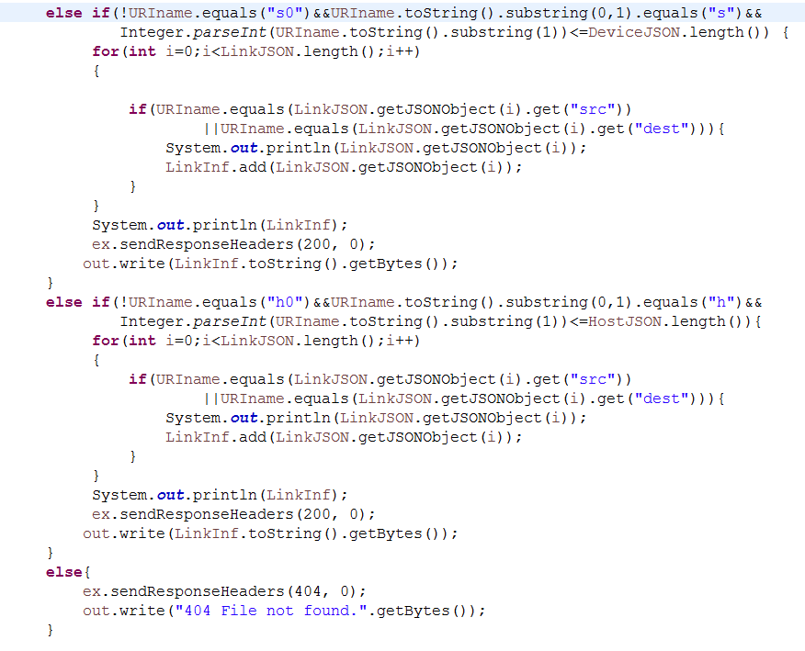
5.1.3) Code Explanation- GET Link information
Link Handler
Find one switch’s link
Find one host’s link
Build 404 Response

Slide 39
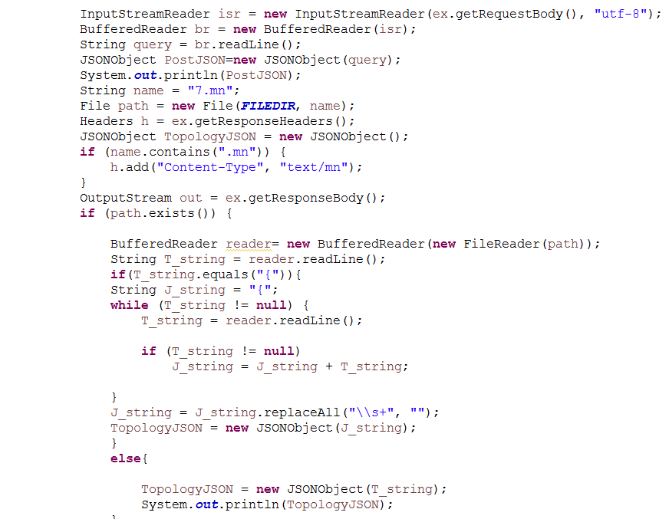
5.2) Code Explanation- POST
DevicePOSTHandler
get string from client
Access the file
Parsing JSON

Slide 40
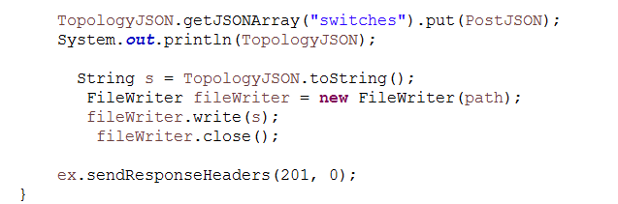
5.2) Code Explanation- POST
DevicePOSTHandler
Add switch and build responnse

Slide 41
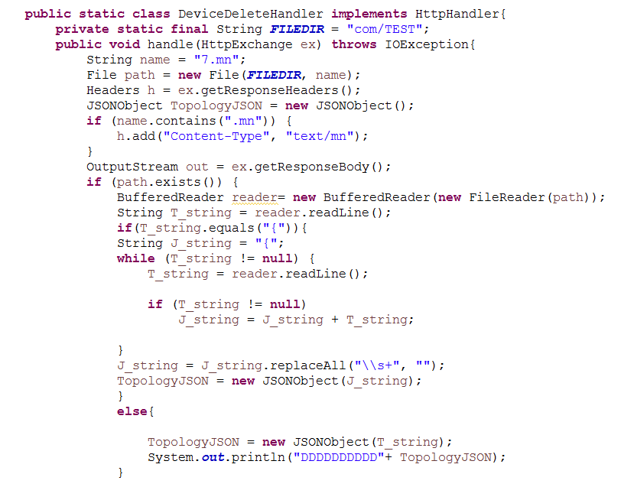
5.3) Code Explanation- DELETE
DeviceDeleteHandler
Access the file
Parsing JSON

Slide 42
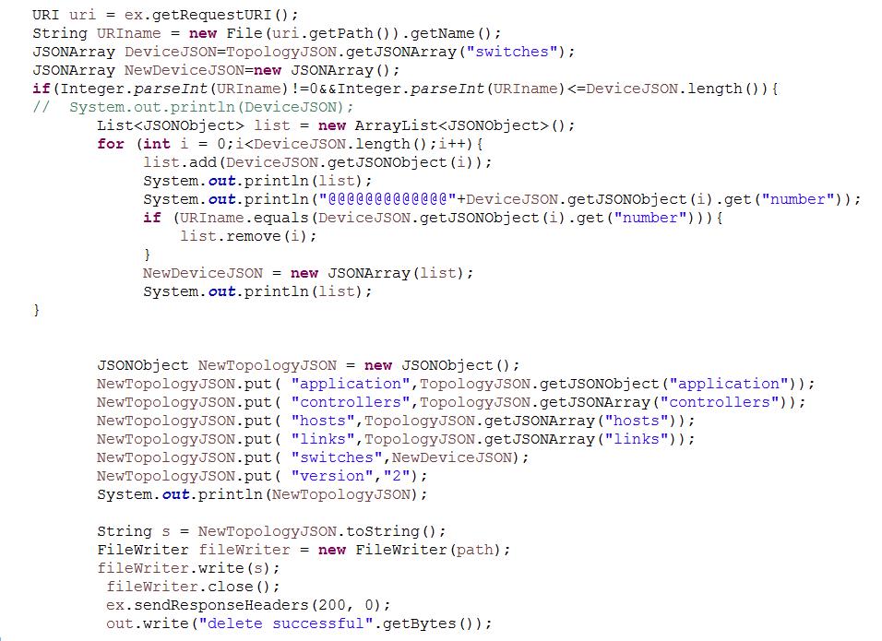
5.3) Code Explanation- DELETE
DeviceDeleteHandler
Delete device JSON object
Write new topology JSON

Slide 43
5.3) Code Explanation- DELETE
HostDeleteHandler
Access the file
Parsing JSON

Slide 44
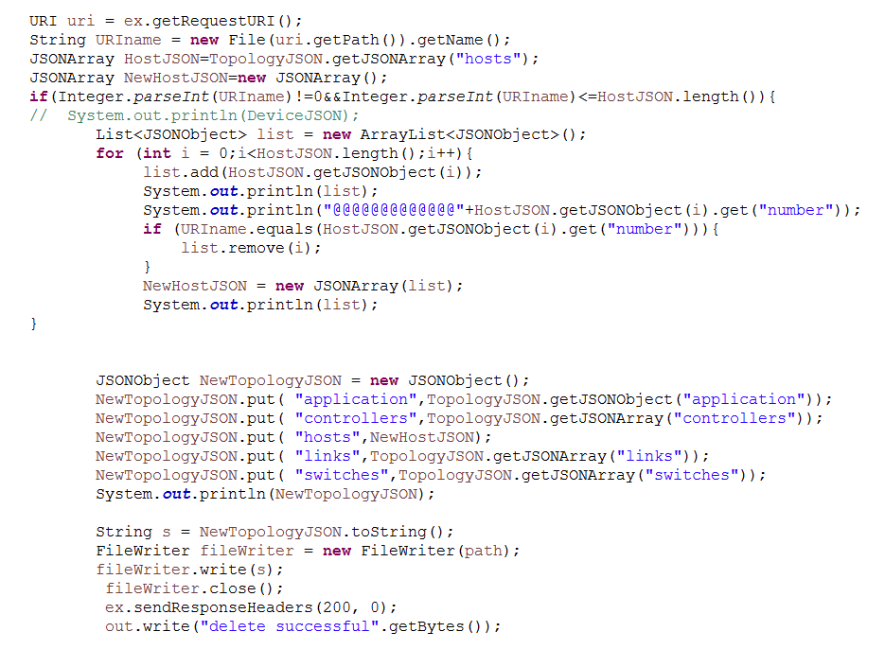
5.3) Code Explanation- DELETE
HostDeleteHandler
Delete host JSON object
Write new topology JSON

Slide 45
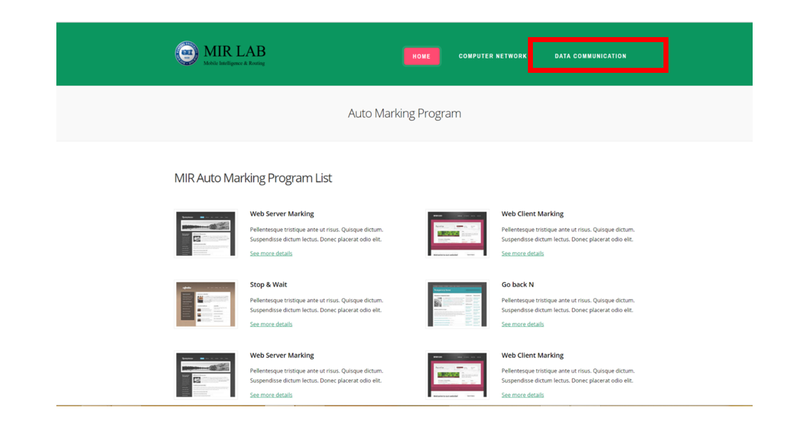
6.1) How to execute (Screenshot)
1. Approach http://166.104.143.225:9998/index.html# through your web browser (Internet Explorer, Chrome, Firefox and etc.), click DATA COMMUNICATION

Slide 46
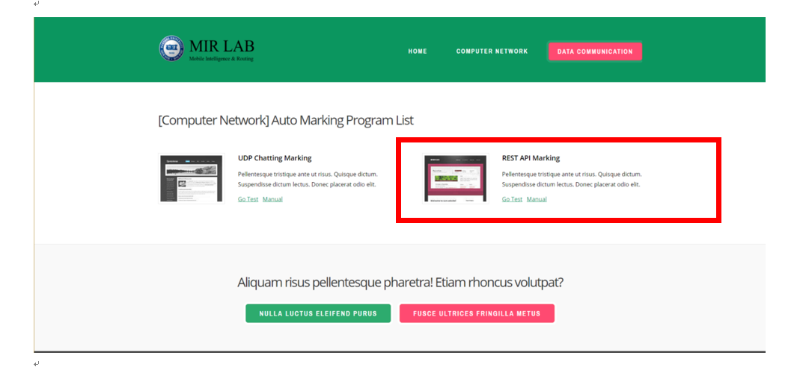
6.2) How to execute (Screenshot)
2. REST API Marking-> Go Test

Slide 47
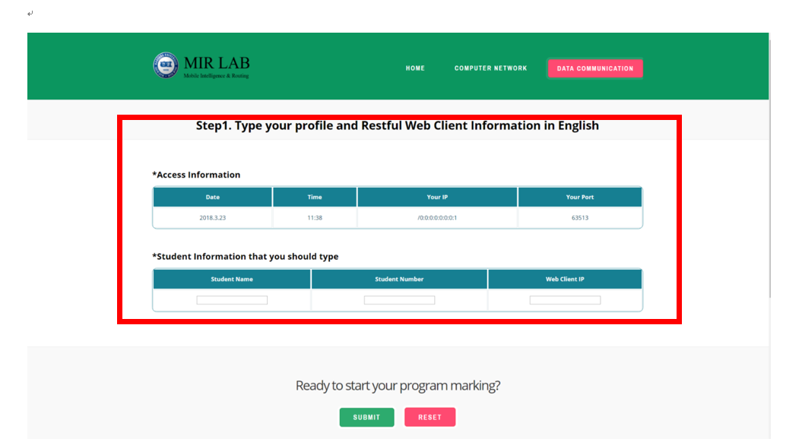
6.3) How to execute (Screenshot)
3. Input your name, student number and client IP.->Submit

Slide 48
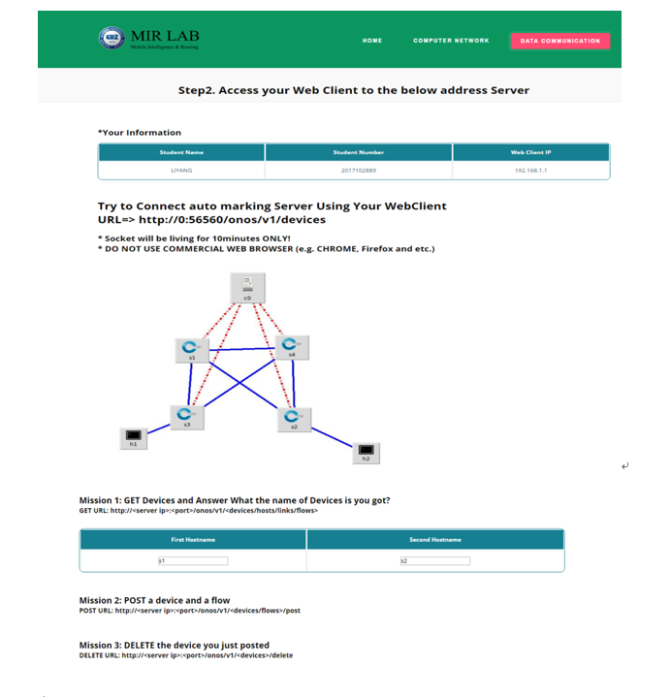
6.4) How to execute (Screenshot)
4. You can see the port you need to connect to the server and must commit several missions to test your restful web client

Slide 49
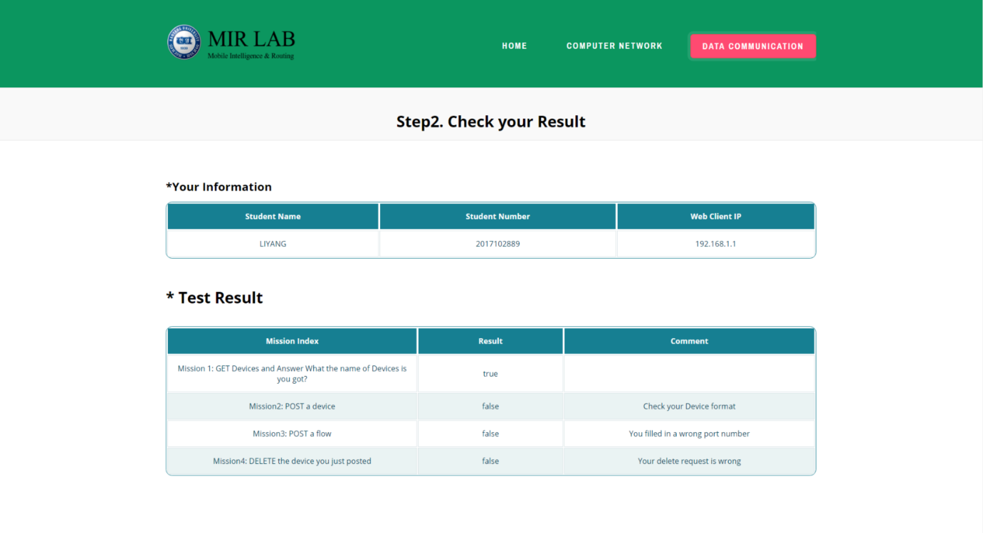
6.5) How to execute (Screenshot)
5. Result Page

